Slide 1
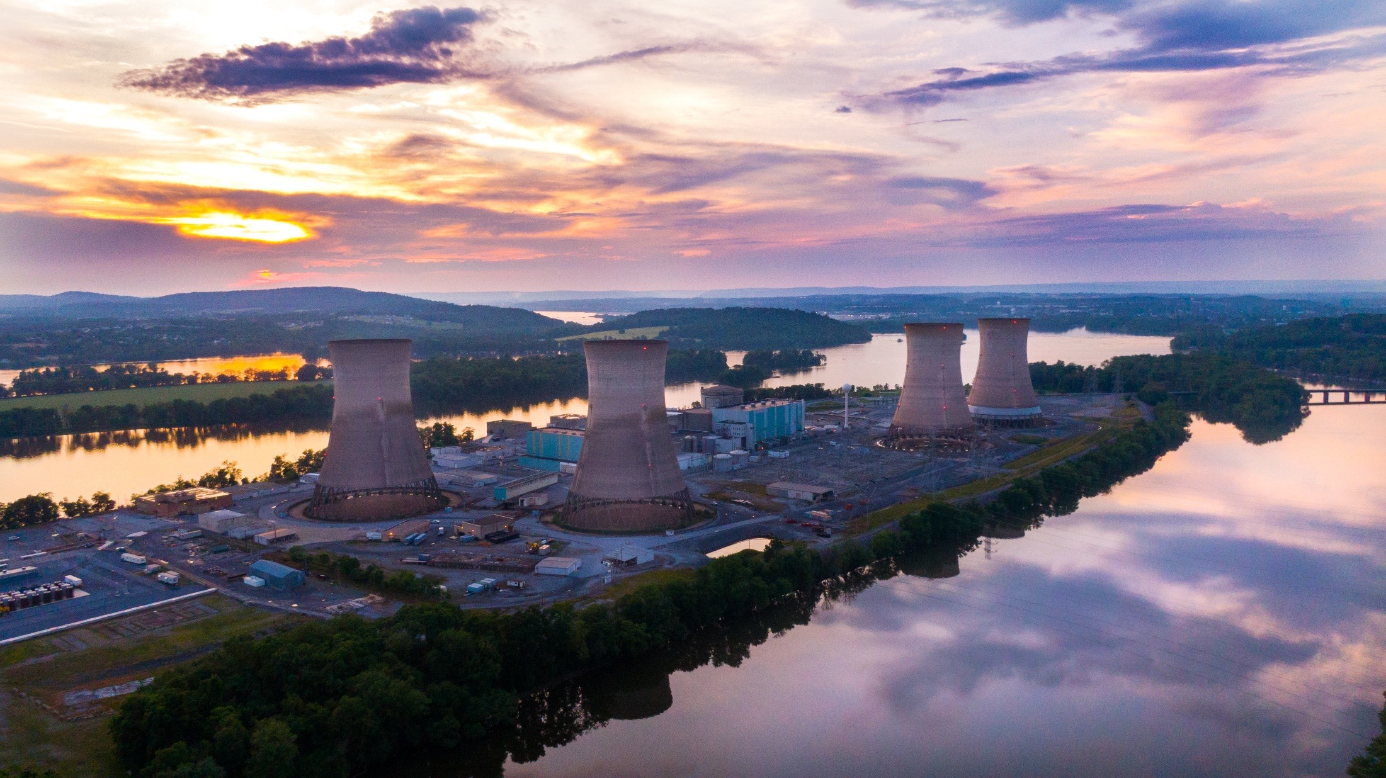
TMI-2 CAP Meeting
Date: September 14, 2022
Time: 6:00pm – 7:30pm Location: Virtual via Microsoft Teams, accessible through
www.tmi2solutions.com
Dial In: +1 385-500-4880
With Conference ID 612222219#

Slide 2
Welcome & Attendance
Steve Letavic
Chairman, TMI-2 Community Advisory Panel

Slide 3
Agenda
Decommissioning Status
Regulatory Update
Preservation & Outreach
PADEP Bureau of Radiation Protection
Nuclear Regulatory Commission
CAP Business & Open Discussion
Community Q&A

Slide 4
Decommissioning Status
Frank Helin
TMI-2 Project Director

Slide 5
Project Performance
Overall Assessment
Safety performance remains very good
Team remains focused on planning and program readiness including technology assessments
Schedule and budget performance very good
Challenges/Risks
Obtaining additional Emergency Plan update and approval for decommissioning (DECON)
NRC approval of DECON License Amendment Request (LAR) expected by January 2023
Incorporating an early aggressive dose reduction approach to sequencing work

Slide 6
Safety Performance
Safety performance remains very good, with some minor occurrences:
Worker became weak during respirator testing and fell, injuring an elbow
Worker slipped on debris in truck and strained a hamstring
Worker tripped in a clean (non-contaminated) area which aggravated a pre-existing condition; individual requested an ambulance and received care upon reaching the ER
Weekly safety stand down meetings now occurring to ensure focus remains on safe work practices

Slide 7
Project Highlights
Shifting procedures and processes from TMI-1 to ESJ
Radiological Protection Program
Fire Protection Program
Engineering
TMI-2 Materials Security Plan implemented (30 August 2022)
Using TMI-1 support under contract
Performing in-depth surveys of Reactor Building, Auxiliary Building, and Fuel Handling Building to finalize plans to address source term reduction
Focusing on protection of personnel and minimizing radiological risk

Slide 8
Critical Path
Critical path for active decommissioning (DECON) depends on the NRC approval of the DECON License Amendment Request (LAR)
Currently addressing NRC Requests for Additional Information (RAIs)
Working on addressing TMI Site Emergency Plan revision to support entry into DECON
Expect NRC approval by end of 2022 / beginning of 2023
Preparations for entering active decommissioning in early 2023
Removal of Equipment Hatch
Design and construction of Decommissioning Support Building (DSB) and Interim Waste Storage Facility (IWSF)

Slide 9
Project Focus Areas
Current Project Work
Designing a structure to support material handling (DSB)
Dose reduction efforts
Programs on track to implement DECON LAR when approved with multiple readiness reviews being performed
Continue to work closely with Constellation/TMI-1 on:
Support Services (e.g., Security)
Combined Site Wide programs (e.g., environmental monitoring)
TMI Site Emergency Plan

Slide 10
Project Focus Areas
Staffing
Obtaining needed staff onsite for support and operations
RP technicians for ongoing Reactor Building surveys
Currently 8 craft labor personnel which will grow to 52 by mid-October
ESJ uses 100% craft labor from local union halls, except when specialty labor is needed
Dose Reduction
Reviewing advances in technological methods to perform remote work with minimal risk for exposure to personnel
Program transfers from Constellation
Radiological Protection – complete
Security – complete
Other programs scheduled for transition in 2023

Slide 11
Regulatory Update
Timothy Devik
Licensing Manager, TMI-2

Slide 12
Overview
PDMS to DECON License Amendment Request (LAR) Status
TMI-2 Security LAR Status
Emergency Plan LAR Status
Records Exemption Status
NRC Inspection Status
Searching on NRC ADAMS

Slide 13
PDMS to DECON License Amendment Request (LAR) Status
Original Submitted February 2021
Working through NRC Requests for Additional Information (RAIs)
Fire analysis bases
Special Nuclear Material accountability and control
Emergency Plan update to account for TMI-2 Decontamination activities
Target for NRC approval is end of 2022

Slide 14
TMI-2 Security License Amendment Request (LAR) Status
Original submittal May 2021
License Amendment approved on 30 August 2022
Implemented TMI-2 Materials Security Plan under contract with TMI-1 to provide services
Coordinated implementation with TMI-1 implementation of ISFSI Security Plan and with TMI-1 Materials Security Plan

Slide 15
Emergency Plan License Amendment Request (LAR) Status
ISFSI-only Emergency Plan submitted for TMI site March 2021
PADEP noted that Emergency Plan assumed TMI-2 would remain in Post-Defueling Monitored Storage (PDMS) condition
TMI-2 revising Emergency Plan for DECON condition to support DECON LAR
TMI-2 will remain in PDMS condition until DECON LAR approval, with DECON Emergency Plan implemented
Coordinating Emergency Plan update with TMI-1 and NRC

Slide 16
Records Exemption Status
TMI-2 Solutions requested an exemption from some of the NRC record keeping requirements for the life of the license on 5 October 2021
Eliminate requirements for abandoned equipment
Supplemented in December 2021 to address NRC Orders regarding maintenance TMI-2 accident records
Specific Code of Federal Regulations records requirements:
10 CFR 50, Appendix B, Criterion XVII
10 CFR 50.59(d)(3)
10 CFR 50.71(c)
NRC is expected to approve the exemption in the coming weeks

Slide 17
NRC Inspection Status
NRC Inspection Activities 12-15 September 2022
TMI-2 Radiation Protection Program Inspection
TMI-2 Materials Security Program Inspection (10 CFR Part 37)
NRC Management Visit, 12-15 September 2022
Site familiarization

Slide 18
Receive Links for Public Documents for TMI-2 via Email
Go to www.nrc.gov
Select Public Meetings and Involvement
Select Subscribe to Email Updates
Scroll down to Lyris Subscription Services
Click the link to the Decommissioning and Uranium Recovery Correspondence page
Add your name and email address and select Three Mile Island Station, Unit 2 -5000320 (Middletown, PA)
As items are put on the docket, you will get an email notification

Slide 19
Preservation Efforts & Outreach
Hannah Pell
TMI-2 Licensing Engineer

Slide 20
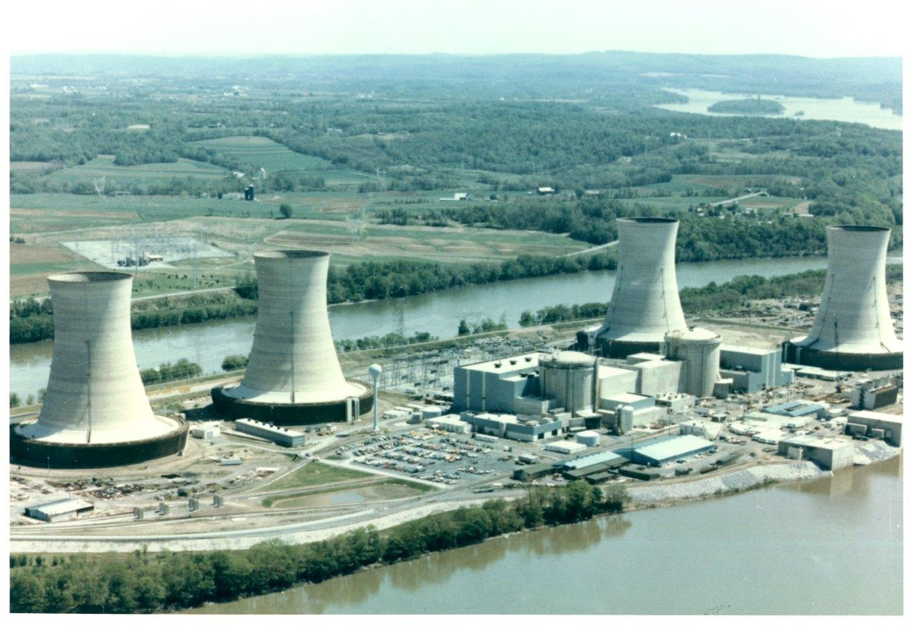
TMI-2 Historic Preservation
Finalized TMI-2 Historic Resource Survey Form (HRSF) draft update with environmental contractors
SHPO reviewing and providing comments
Cultural Resources Protection Plan development to align with HRSF update
Will continue to maintain historical records regarding the TMI-2 accident in 1979 after Records Exemption approval

Slide 21
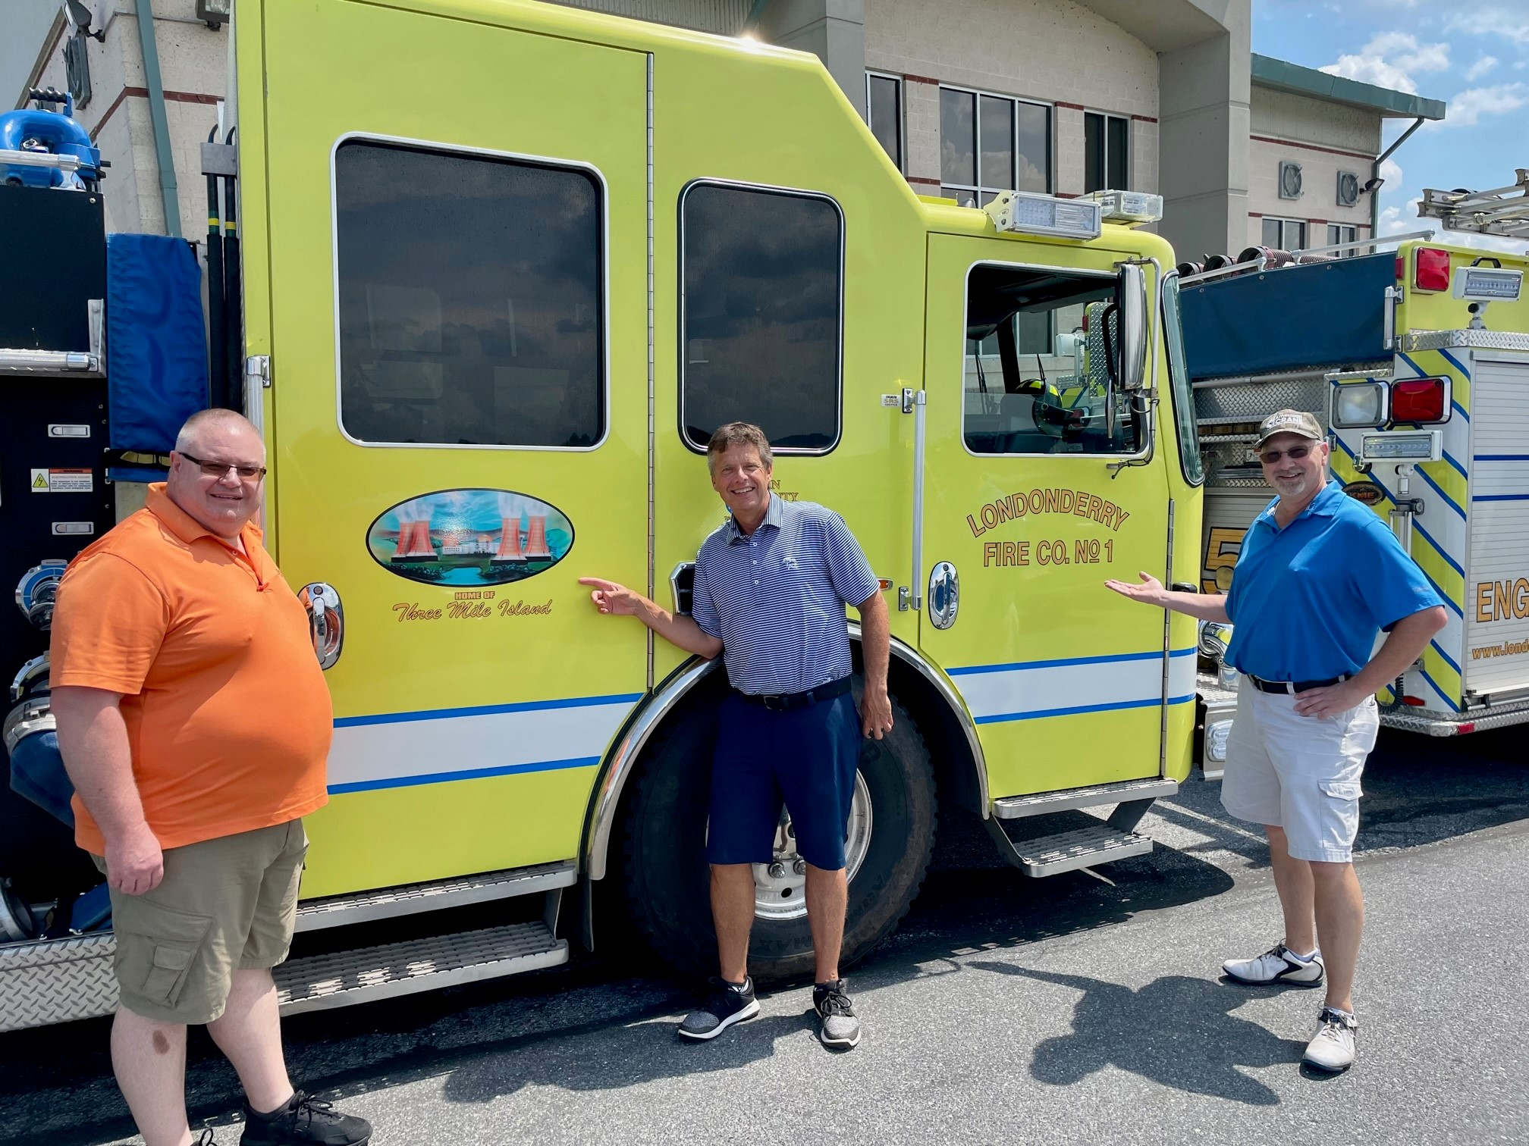
TMI Charity Golf Tournament
18th year of the tournament
Approx. 120 golfers participated in the event w/ 13 volunteers
Approx. 30 industry vendors sponsored golfers or donated
Raised $30,000 for Londonderry Volunteer Fire Co.

Slide 22
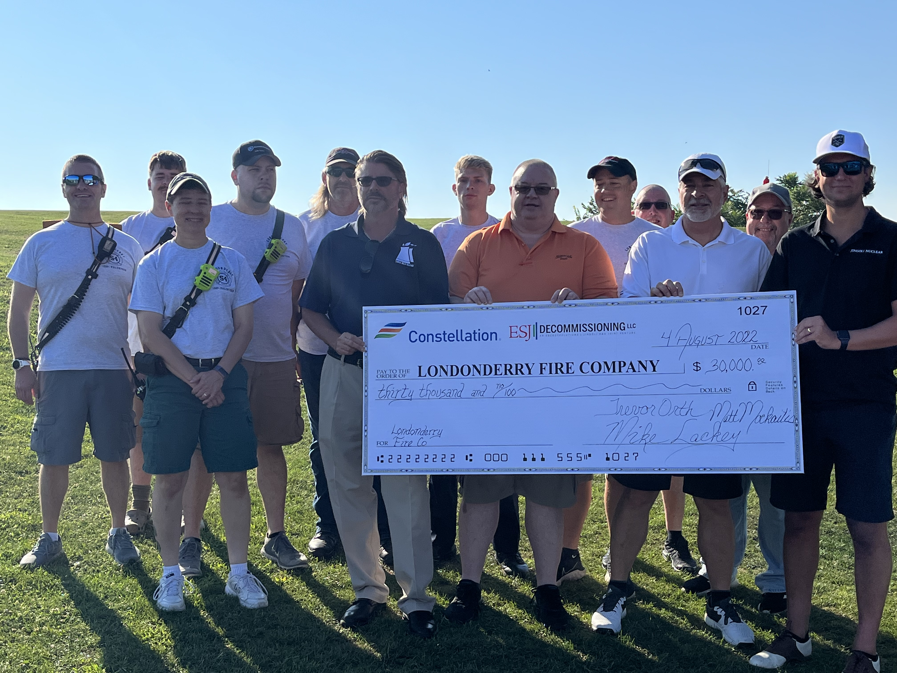

Slide 23
PADEP Bureau of Radiation Protection
Dwight A. Shearer, P.E.
Director, Bureau of Radiation Protection

Slide 24
NRC Reactor Decommissioning Licensing Three Mile Island Station, Unit 2 Community Advisory Panel - Virtual
Amy M. Snyder
Senior Project Manager
U.S. Nuclear Regulatory Commission
14 September 22

Slide 25
Licensing Actions
Amendment Issued:
TMI-2- Amendment No. 65 (ML22189A194 PKG)
Physical Security Plan
(May 13, 2021, ADAMS Accession No. ML21144A262 (non-public) as supplemented on September 21, 2021 (ML21267A505), March 31 (ML22102A304), April 28 (ML22125A013), May 3 (non-public), May 9 (non-public), and May 10, 2022 (ML22131A138)
Amendment Under Review:
Change of License from Possession Only to DECON and change of Technical Specifications
February 21, 2021, ADAMS Package Accession No. ML21057A047, as supplemented on May 5, 2021 (ML21133A264), January 7, 2022 (ML22013A177), March 23, 2022 (ML22101A079), April 7, 2022 (ML22101A077), and May 16, 2022 (ML22138A285)

Slide 26
Licensing Actions
Exemption:
TMI-2- Decommissioning Record Keeping
Request for Exemption from Record Retention Requirements
October 5, 2021 (ADAMS Accession No. ML21279A278, as supplemented, on December 15, 2021 (ML21354A027))

Slide 27
Future Licensing Submittals
Emergency Preparedness Plan – Emergency Action Level Changes - to be submitted TBD

Slide 28
Site Visits Week of September 12
Physical Security Inspection
Site Familiarization visit- NRC HQ staff
Meet and greet
Tour
Decommissioning plans
Environmental Program
Radiological Protection Program

Slide 29
Questions and Contact Information
Questions on Presentation?
Contact Information:
Amy Snyder, Senior Project Manager
Amy.Snyder@nrc.gov
301 415-6822

Slide 30
CAP Business & Open Discussion
Steve Letavic
Chairman, TMI-2 Community Advisory Panel

Slide 31
Community Q&A
Please contact Hannah Pell at hepell@energysolutions.com
with any additional questions or requests for information.

